Slide 1
Build a basic Connector
Card Design & Incoming Webhooks

Slide 2

Card Design & Incoming Webhooks
Design Guidelines
Card Sections and Fields
Security and Storage requirements for Webhooks
Demo

Slide 3

Office 365 Platform
EXTENSIONS
Common across canvases
Action
Task pane
Dialog box
Event
DOCUMENTS
PAGES


CONVERSATIONS
CANVASES
Canvas specific
extensions
Data import
Dictionary
Connectors
Actionable emails
Navigation
Branding
Notes:
Connectors is part of the Office 365 Platform canvas for conversations

Slide 4
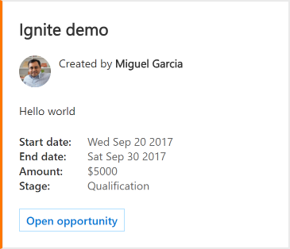



Connector Cards
Rich Content
Rich Text (Markdown)
Images
Sections
Fields
Across Office 365 Workloads
Outlook 2016 & web
Groups mobile iOS & Android
Microsoft Teams desktop, web and mobile
Yammer desktop, web and mobile
Notes:
Cards support rich content that is formatted to fit the canvas
All conversation tools are supported, across platforms

Slide 5
Design Guidelines – Text
Text formatting: Basic Markdown
Effect | Markdown
Italics | *Italic*
Bold | **Bold**
Bold Italics | ***Bold Italic***
Strikethrough | ~~Strikethrough~~
Links | [Microsoft](https://www.microsoft.com)
Headings (H1 thru H6) | # Heading through ###### Heading
Bulleted Lists | * List Item or - List Item
Notes:
HTML is ignored and treated as plain text

Slide 6
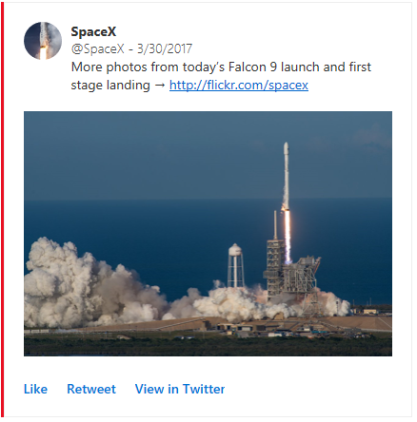

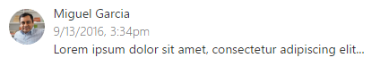
Design Guidelines - Images
images Field
Photo Gallery inside a section
Rendering depends on app/device
Scroll/Swipe to review
heroImage Field
Image is centerpiece of card
Can be used to provide a banner
activityImage Field
Image & text displayed in two-column layout
Use for scenarios:
Someone did something
News article abstract
Notes:
Add images as appropriate, in the layout that best conveys the meaning

Slide 7
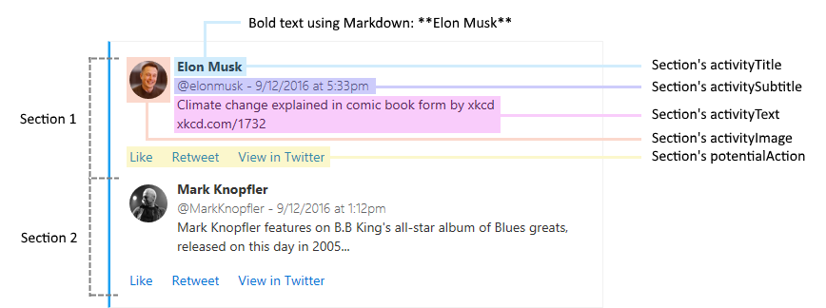
Design Guidelines - Sections
Sections
Use to logically group data together
Don’t include more than 10
Notes:
Cards are meant to be easy to read; if there is too much information in a card, it will be lost on the user.
For digest-like cards, consider adding a "View full digest" action at the end of the card.

Slide 8
Card Sections and Fields
“Content over chrome”
Card Fields
Title
Summary
Text
Theme Color
Potential Actions
Section Fields
Title
Text
Activity Text/Image
Images / Hero Image
Facts
Potential Actions
Notes:
Provide data in well-defined fields. Rendering is handled by host application

Slide 9
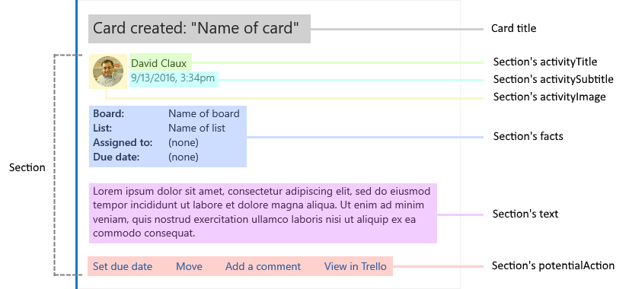
Connector Cards – Design Guidelines
Notes:
Put it all together
Example on web includes json: https://docs.microsoft.com/en-us/outlook/actionable-messages/card-reference#card-examples

Slide 10
Security Requirements
Use HTTPs
Pages must use HTTPS
Landing / Configuration pages capture data
Registration Callback will not occur w/o HTTPS
Secure the webhook URL
Webhook URL is passed as query parameter
Can be disclosed if Callback page has links to other websites
Implement a redirect or referrer policy
Once data is stored, redirect browser to page w/o query parameters (HTTP 302)
Add <meta> tag to page header
<meta name="referrer" content="no-referrer">

Slide 11
Storage Requirements
Connecting to Office 365 generates registration data
State
Send state value during request.
Same value should be returned
Webhook URL / App Type
Associate the URL with the App Type (Group/Teams/Mail)
Ensure card is supported by App
Group Name / User ObjectID
Identifies destination of posted data
User Identifier – store securely!
Ensure content is relevant

Slide 12
Demo Send a Connector Card via Incoming Webhooks
Notes:
Review various cards in playground: https://messagecardplayground.azurewebsites.net/
Point out that Incoming Webhook requires user to capture and store information. A programmatic way to do that is in following section

Slide 13

Summary

Slide 14
Thank you

